Slide 1
Course Project
李培莹，黄文静

Slide 2
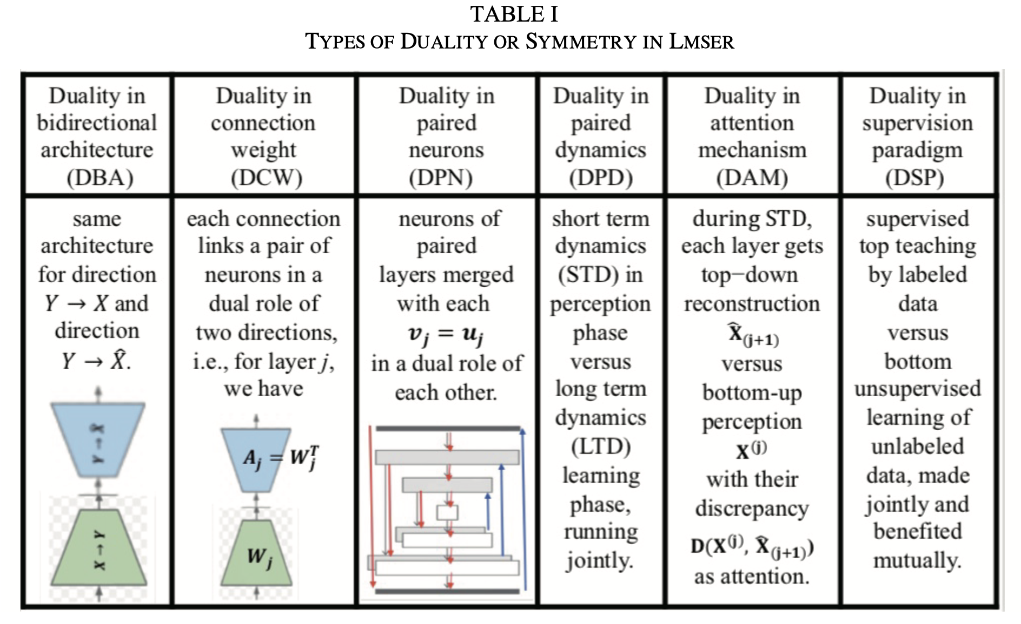
Lmser
Least Mean Square Error Reconstruction for the self-organizing network (Lmser) was proposed in 1991, featured by a bidirectional architecture with several built-in natures.
Image Source: Xu, 2019,An Overview and Perspectives On Bidirectional Intelligence: Lmser Duality, Double IA Harmony, and Causal Computation

Slide 3
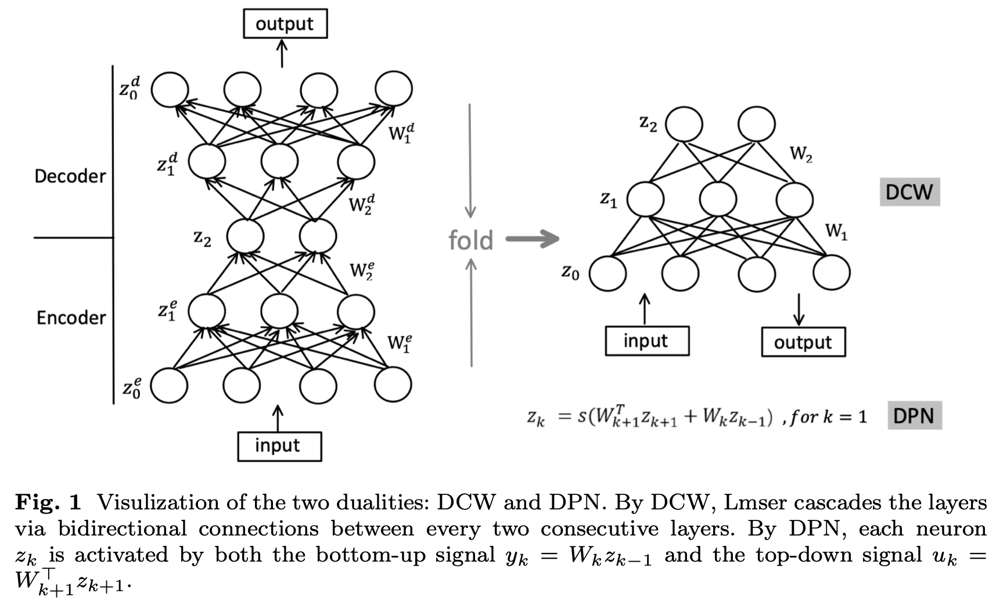
Two dualities in Lmser：
Duality in connection weight
Duality in paired neurons

Slide 4
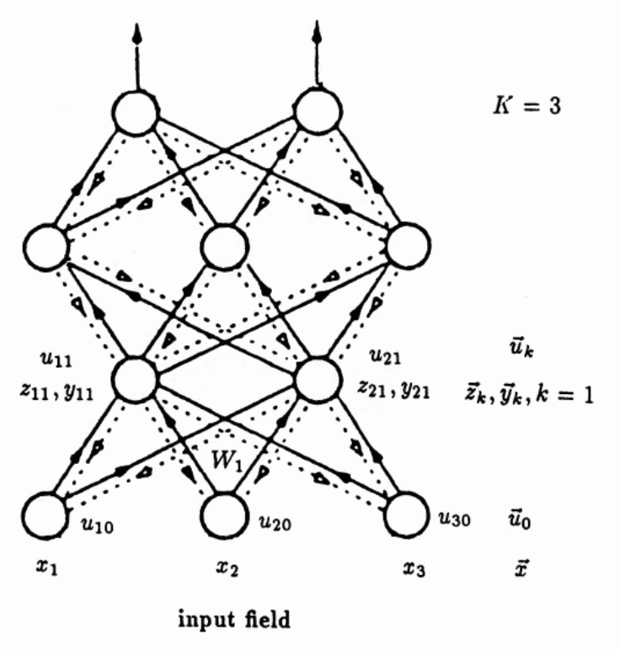
The Lmser net works in two phases, i.e., perception phase and learning phase.
In the perception phase, the input triggers the dynamic process by passing the signals up from the bottom layer, while simultaneously the signals in the upper layers will be passed down to the lower layers.
In the learning phase, the parameters are updated by minimizing the mean square error between the input and reconstruction.
In the perception phase of Lmser, the signals propagate forwardly and backwardly in a dynamic process which is hard to implement in practice.
Image Source: Xu, 1993, Least Mean Square Error Reconstruction principle for the self-organizing network

Slide 5
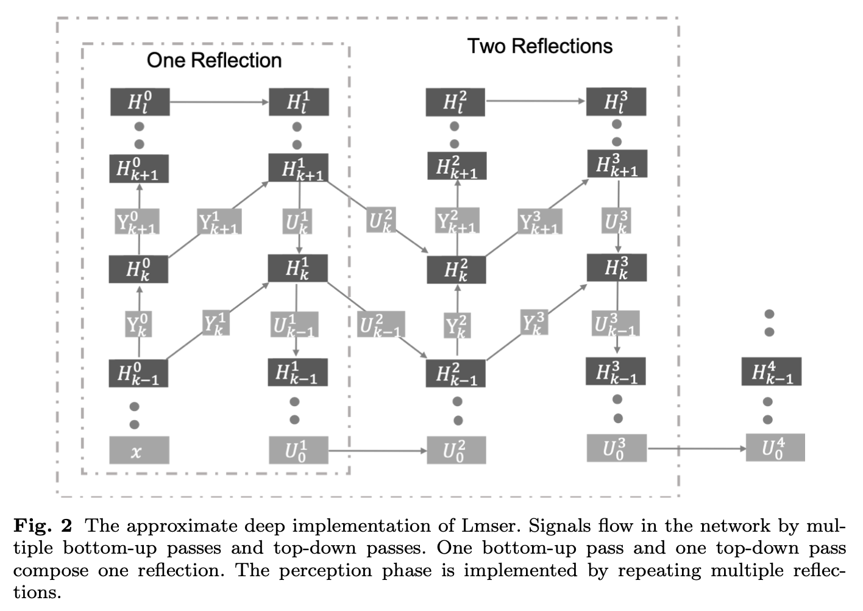
Approximate Implementation of perception phase
视需求而定

Slide 6
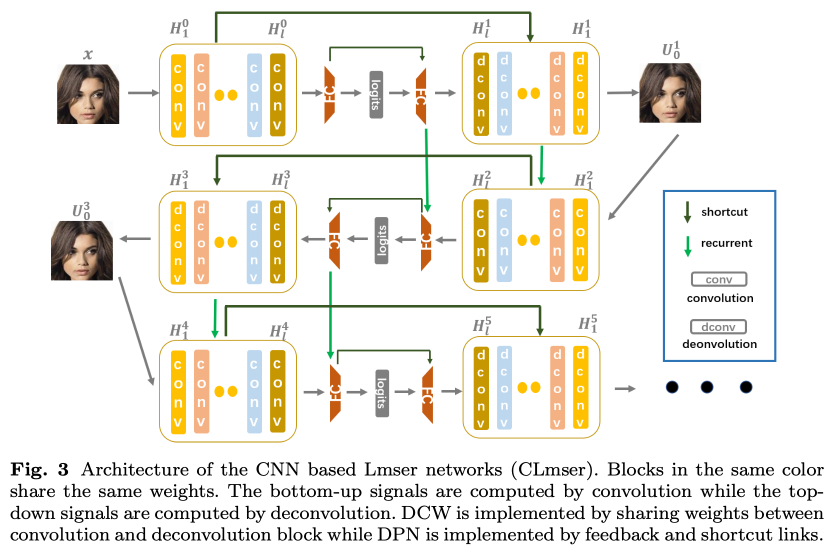

Slide 7
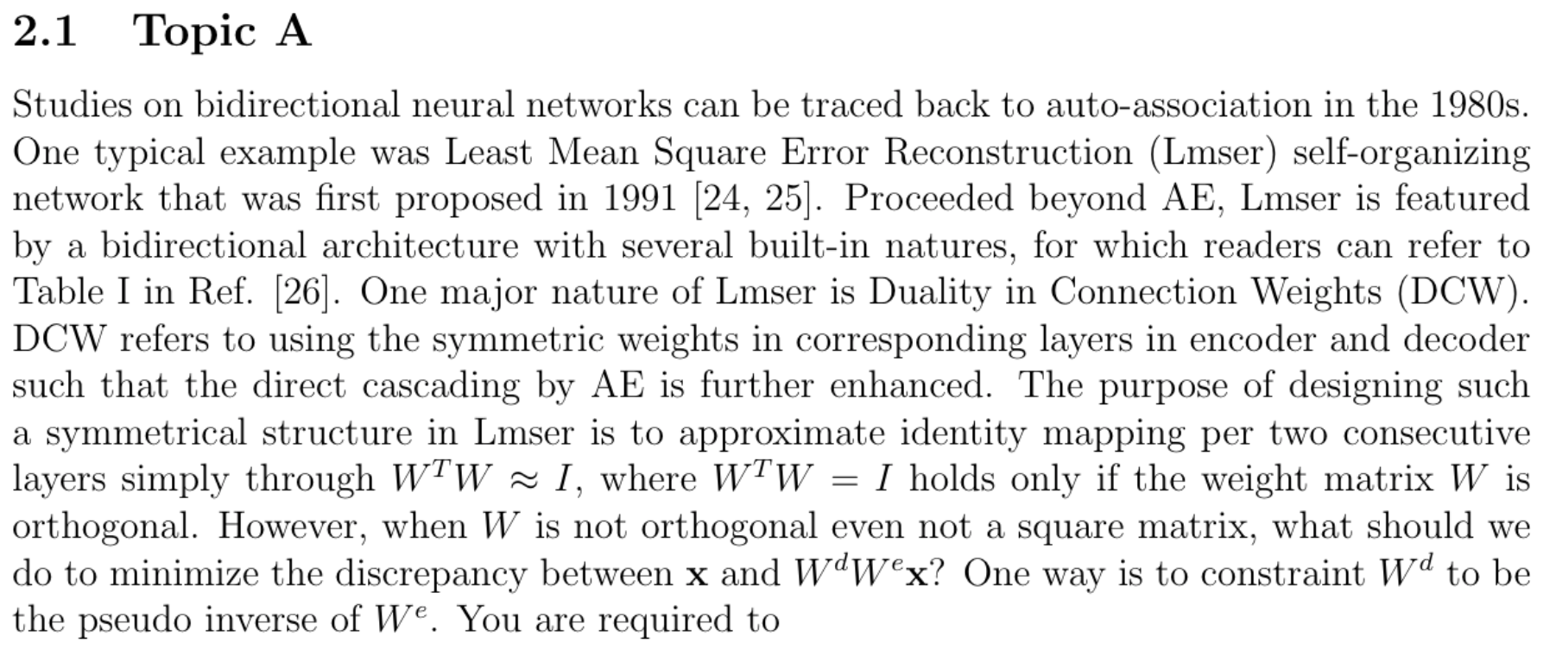

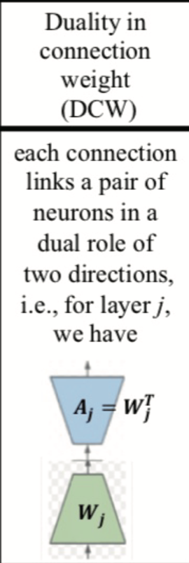
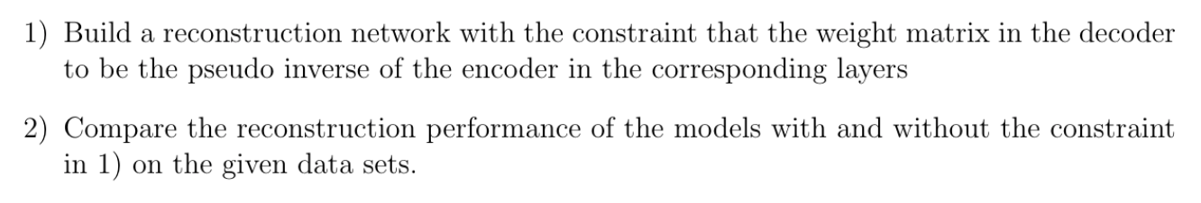
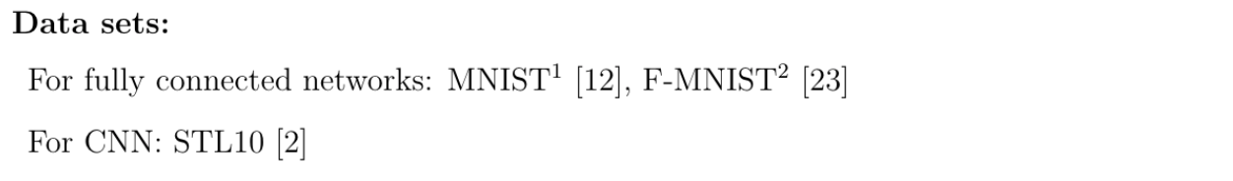

Slide 8
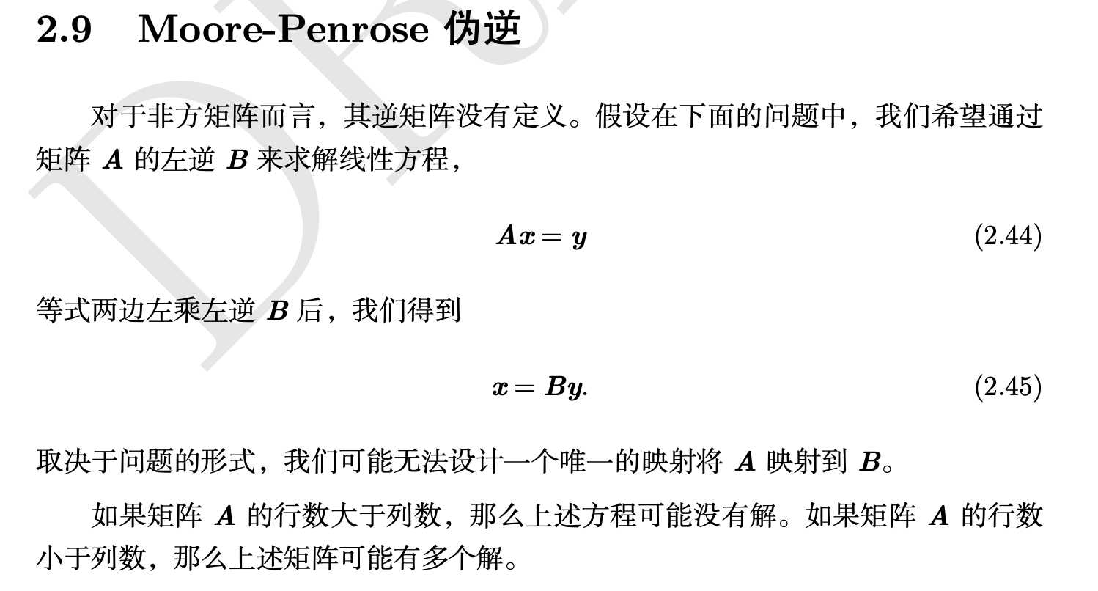
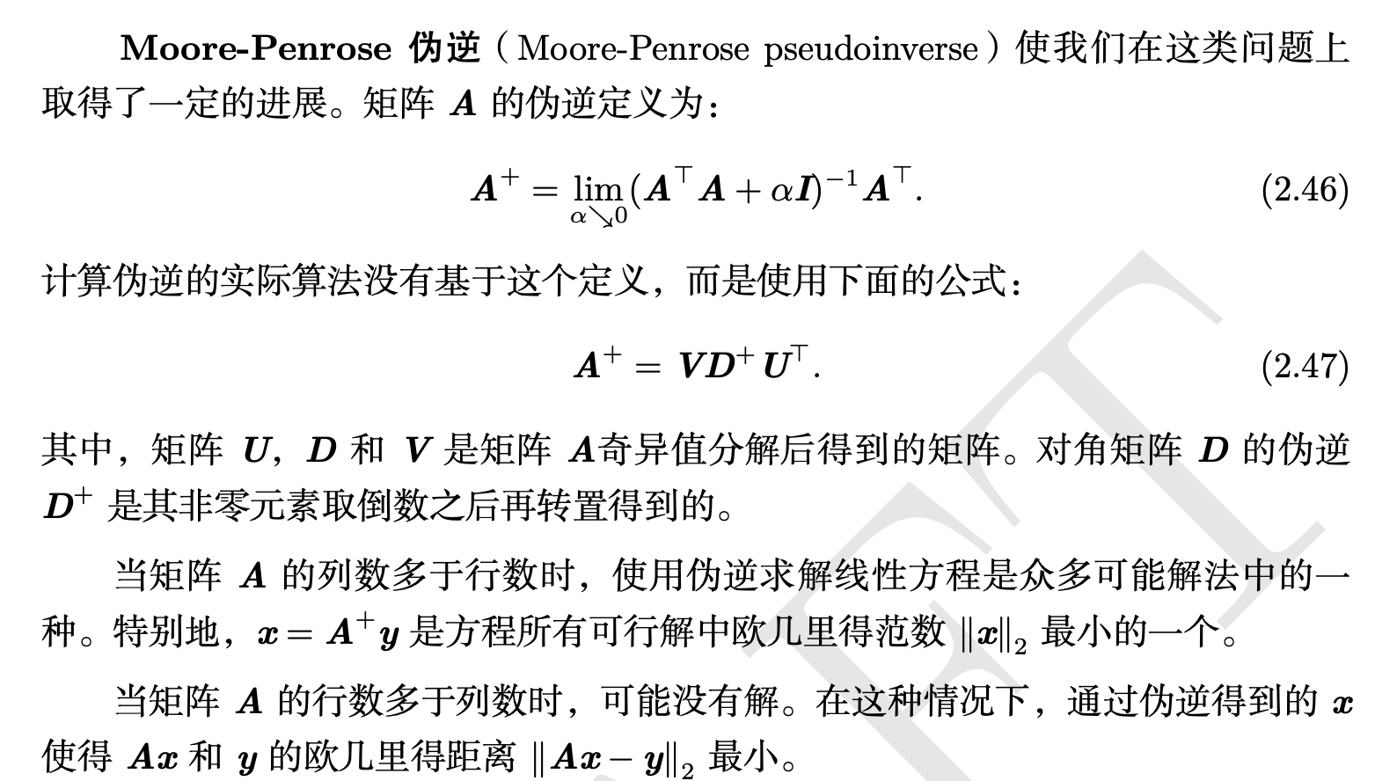

Slide 9
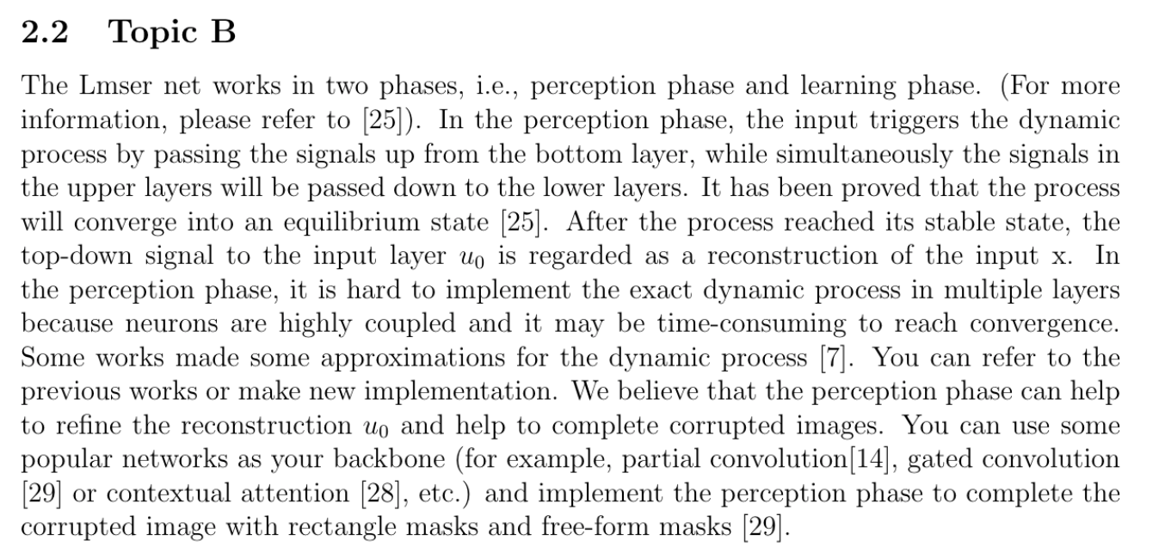


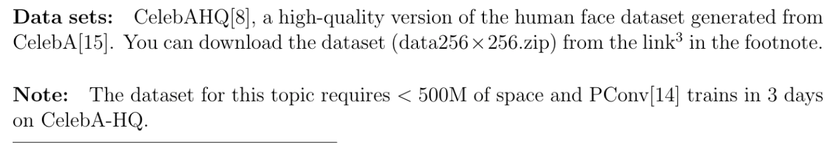
masked
completed

Slide 10
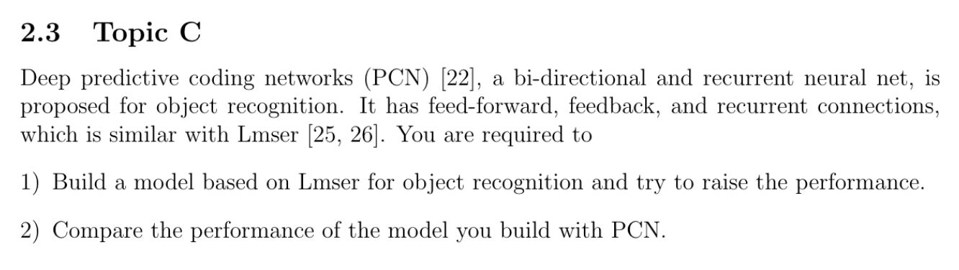

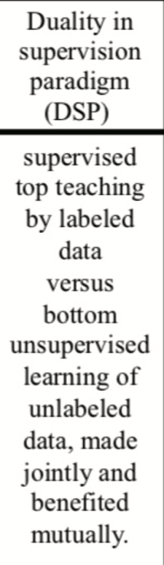
Image Source: Xu, 1993, Least Mean Square Error Reconstruction principle for the self-organizing network

Slide 11
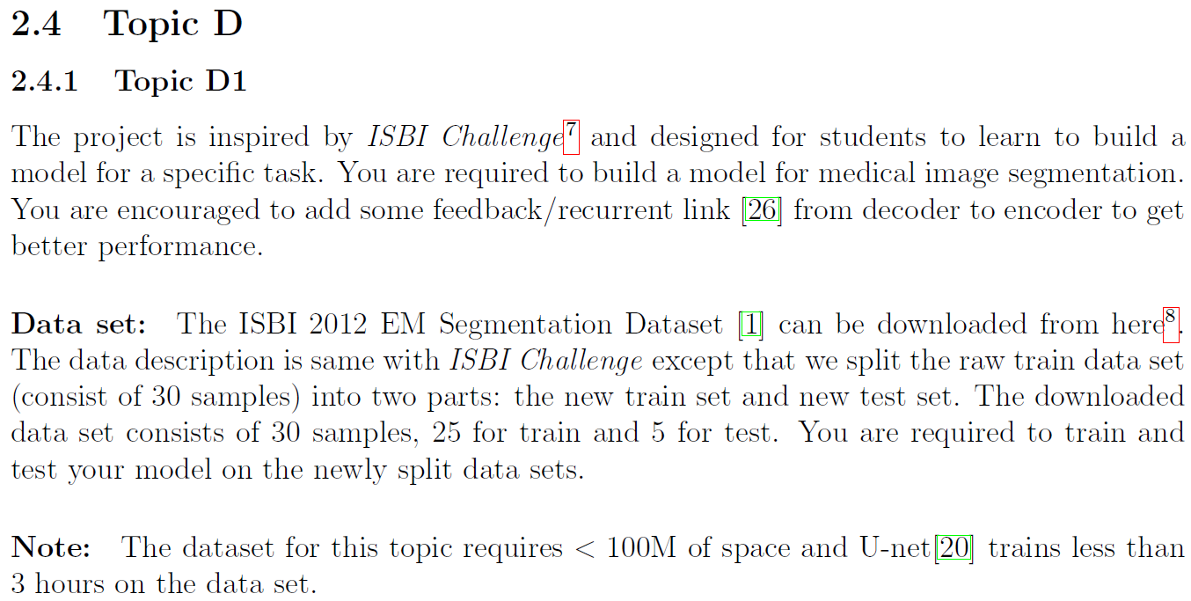
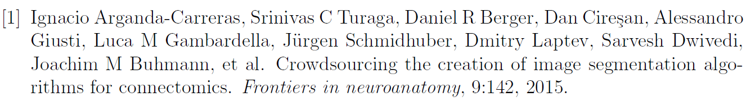

Slide 12
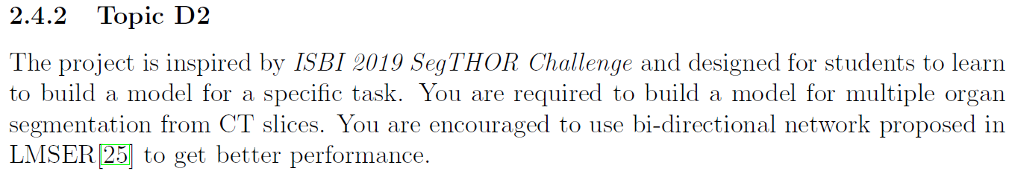
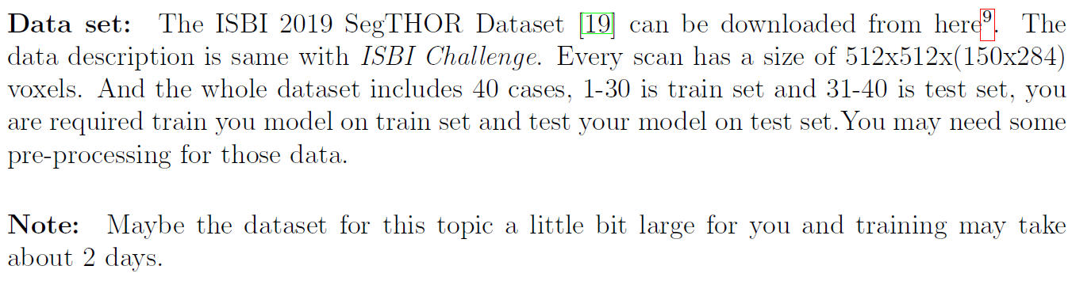

Slide 13
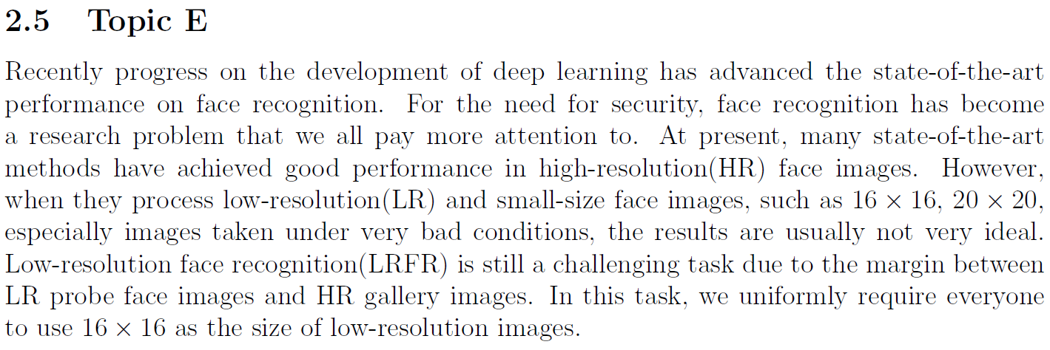
Test mode
1:1 (verification) Determine whether two images are from the same person
1:N (identification) Match the target face from the gallery. There are also distractors in the gallery.

Slide 14
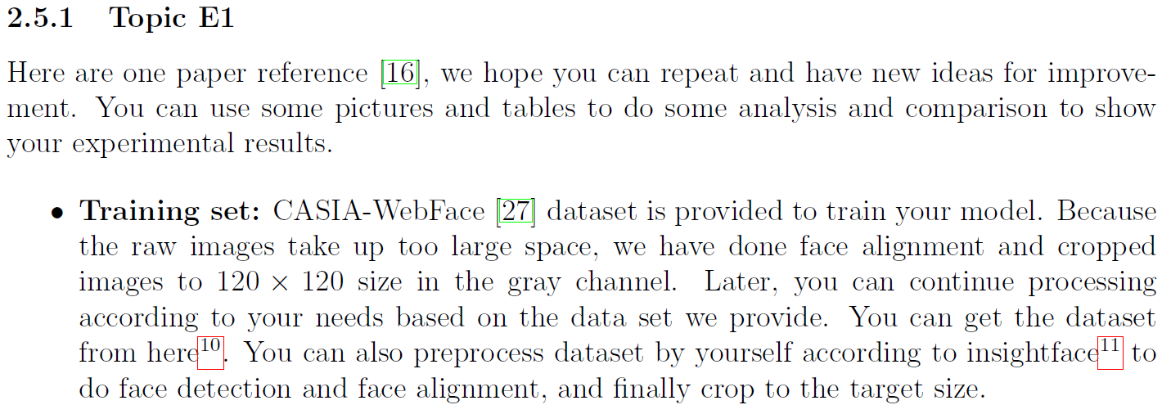

Slide 15
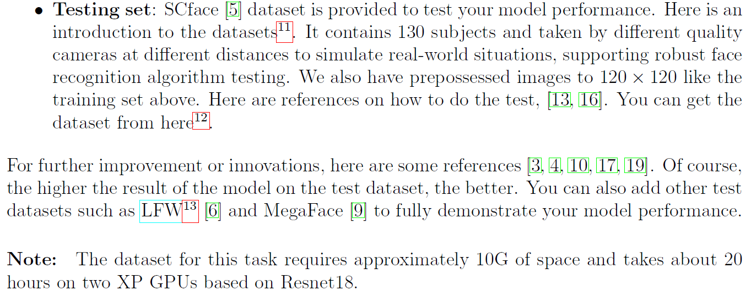

Slide 16
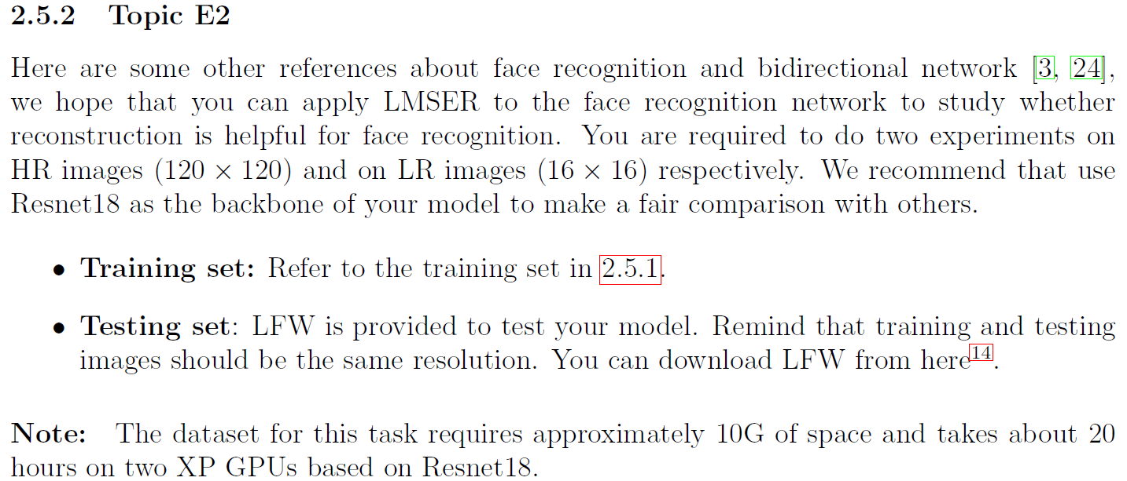

Slide 17
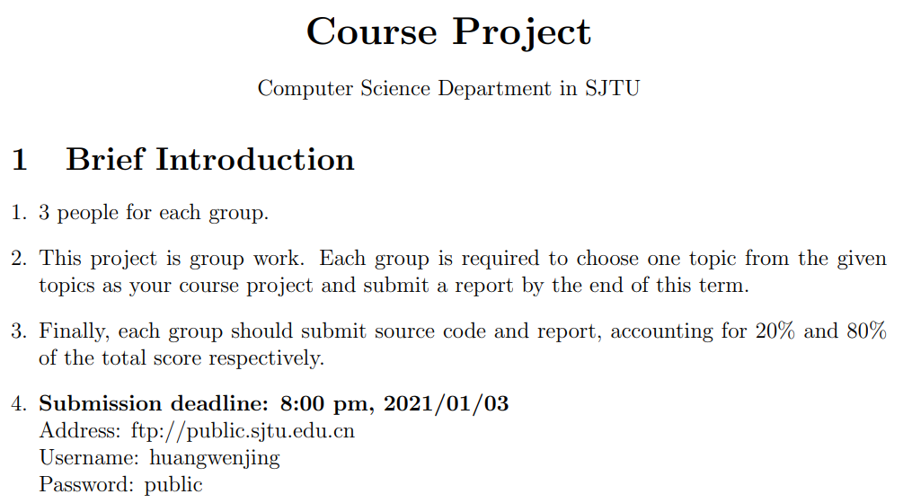

Slide 18
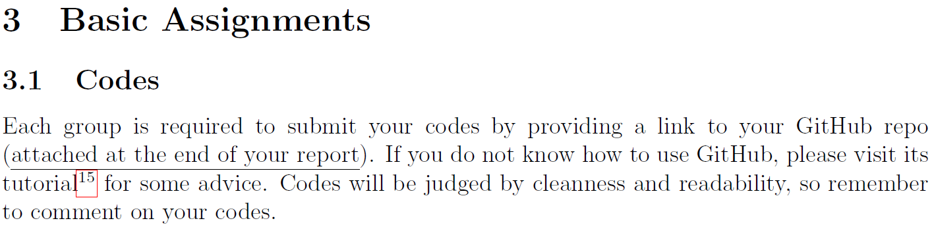

Slide 19
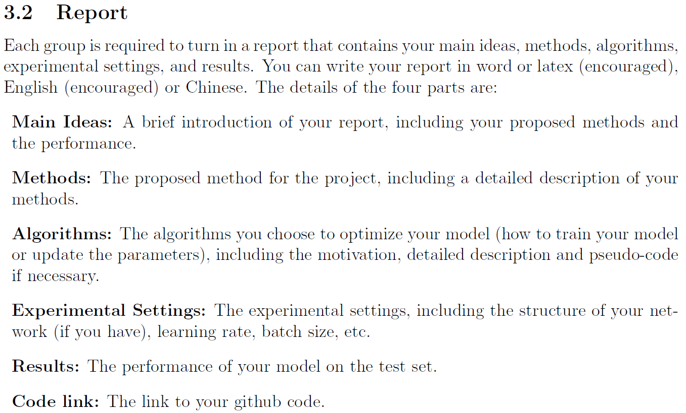

Slide 20
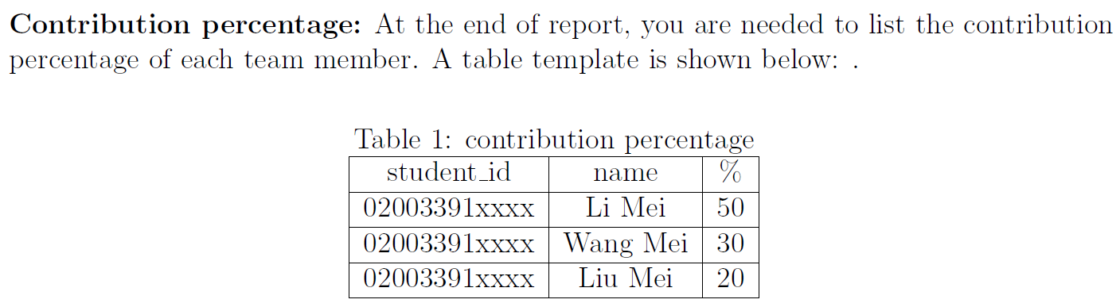

Slide 21
About choosing topic:
There are 19 groups in class, 7 topics.
1 topic / 2~3 groups
Each group has 100 points to choose the topic you want to do. You can choose many topics and assign them different points to represent the degree of your desire. The more points, the greater the probability of selection. Remind you that there are only 100 points for each group.
Of course, you can put your 100 points on one topic, but if this topic is selected by many groups, we will eliminate some groups randomly. Then you don't have a second choice, we'll assign you random topic.
We suggest that “Do not put eggs in the same basket”
A
B
C
D1
D2
E1
E2
Each group is required to send your decision to the following emails before 20:00, October 25 ：
huangwenjing@sjtu.edu.cn or lipeiying@sjtu.edu.cn
Example：
Subject: group3_topic
Content: A(0) B(40) C(0) D1(35) D2(0) E1(25) E2(0)

